Slide 1
ANZ Exploratory Data Analysis
By Rishil Ramesh
rishil.ramesh216@gmail.com

Slide 2
About the data:
The dataset contains 12043 transactions for 100 customers.
The dataset contains 28 columns and it consists of 3months of transactions from 01/08/2018 to 31/10/2018.
The data entries are unique and have consistent formats for analysis. Some columns contain missing data (NA cells), possibly due to the nature of transaction.
The columns are:
[‘status’, ‘card_present_flag’, ‘bpay_biller_code’, ‘currency’, ‘long_lat’, ‘txn_description’, ‘merchant_id’, ‘merchant_code’, ‘first_name’, ‘balance’, ‘date’, ‘gender’, ‘merchant_suburb’, ‘merchant_state’, ‘extraction’, ‘transaction_id’, ‘country’, ‘customer_id’, ‘merchant_long_lat’, ‘movement’]

Slide 3
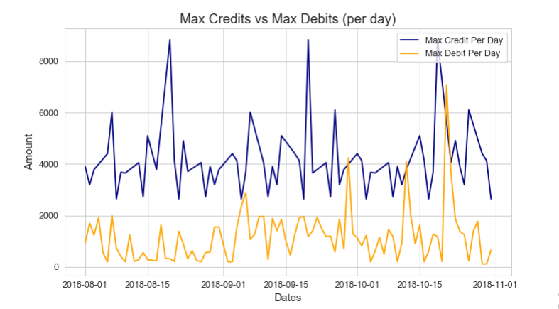
Max Credits vs Max Debits per day

Slide 4
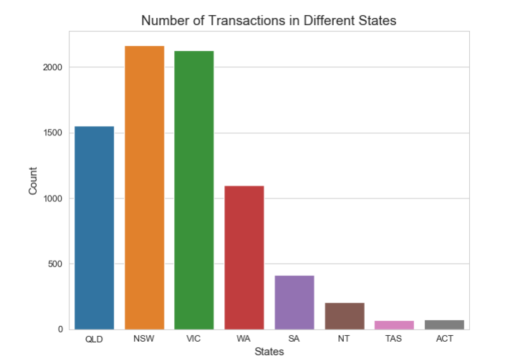
Transaction Count of all States

Slide 5
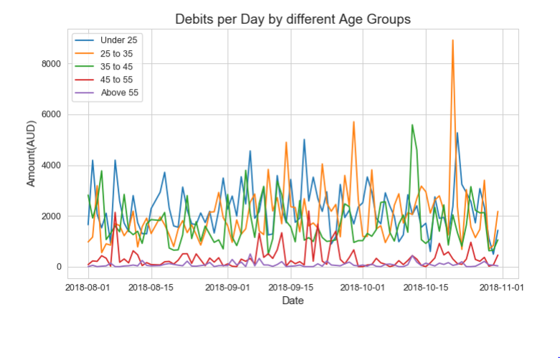
Average amount spent by different Age groups

Slide 6
Insights
Total transaction volume over the dates have ranged from 10,000 to 40,000 usually, mean transactions have ranged from 100 AUD to 300 AUD usually.
Male customers have spent more on their transactions over the dates, as compared to female customers.
States have widely distributed transaction over the dates, but New South Wales and Queensland have had a few peaks in transaction amount.
State wise, New South Wales, Victoria and Queensland have had most number of transactions. The fact that most economic centres and large cities of Australia are in this states also supports the fact.
Average amount spent per day is similar for people with age groups of under 25, 25-35 and 35 to 45 which is around 2000 AUD, but the age group of 25 to 35 have done some transactions which involved a larger amount.
Compared to the above age groups people over 45 years spend much less per day mostly around 500-1000 AUD.

